Slide 1
CSE312
Software Engineering & Project Management
Group 5
Members -
Aditya Srinivas Menon (2020BCS0008)
Sumanth Kotikalapudi (2020BCS0010)
Nishith Baravkar (2020BCS0092)
Vishal Lokare (2020BCS0120)

Slide 2

AutoJoomer
Offline college utility app
Available here - autojoomer.co/download

Slide 3
Problem Definition
No one-stop destination for students to access all information related to college.
It is scattered across emails, several whatsapp groups, LMS, etc.
Tedious task of logging in to college WiFi.

Slide 4
SRS - Functional Requirements
Account creation & authentication
Input - credentials, LMS password
Output - Success -> Homepage, Fail -> Error Message
Mess menu
Class schedule
Important notifications and announcements
Faculty details
Academic calendar

Slide 5
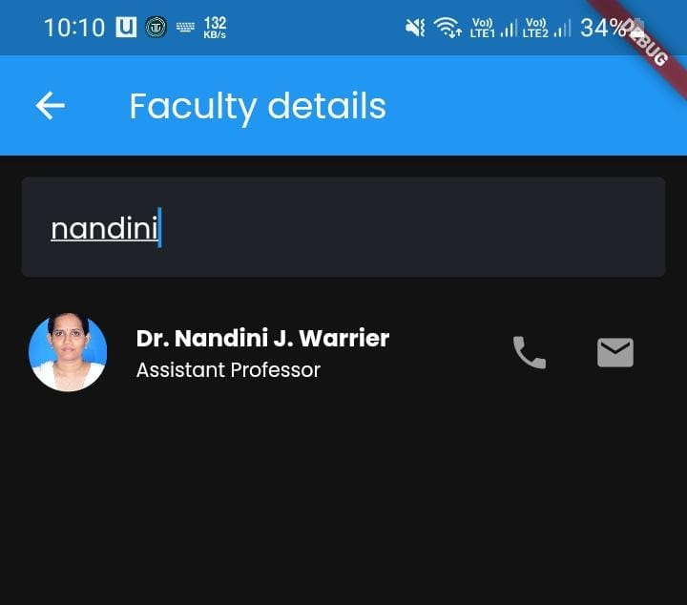
Example of faculty details

Slide 6
SRS - Non Functional Requirements
Portability
Available as mobile application
Security
Secure storage of user credentials like LMS password
Only admins can update data
Maintainability
Regular updates, bug fixes, version control
Usability
Interface has to be user-friendly and easy to use.

Slide 7
Constraints
Currently the app is made only for Android and not for iOS.
Admins should have the changes beforehand and should be available to modify in the backend in a timely manner
Should not exceed the free tier of Firebase, 1GB of data egress, Cloud Storage of 5GB only
Since developers are students, maintenance and updates during exam weeks may get delayed

Slide 8
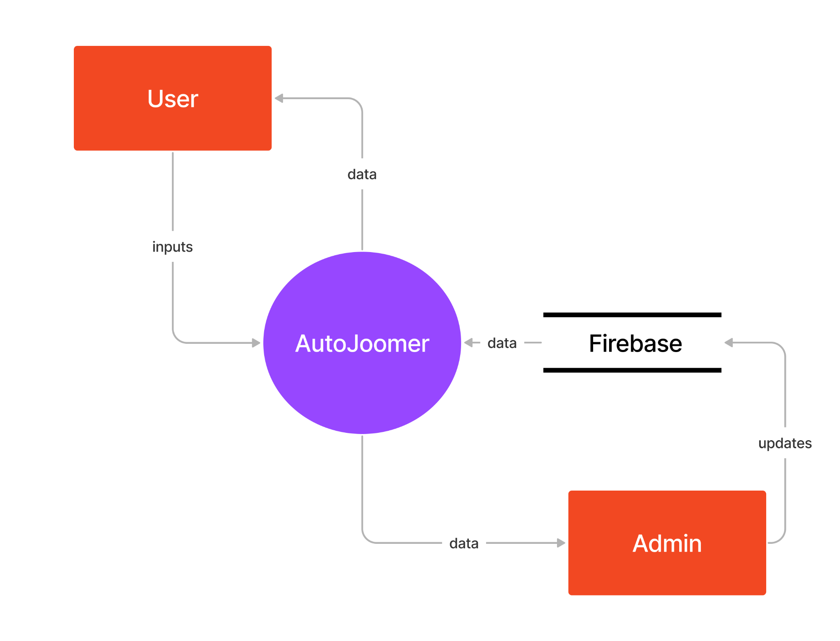
Level 0 DFD
(Context Diagram)

Slide 9
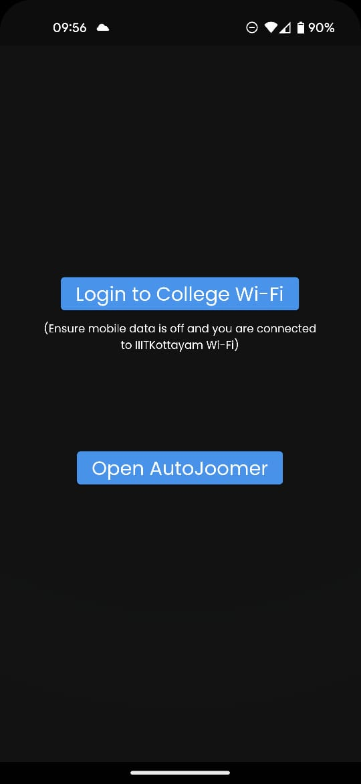
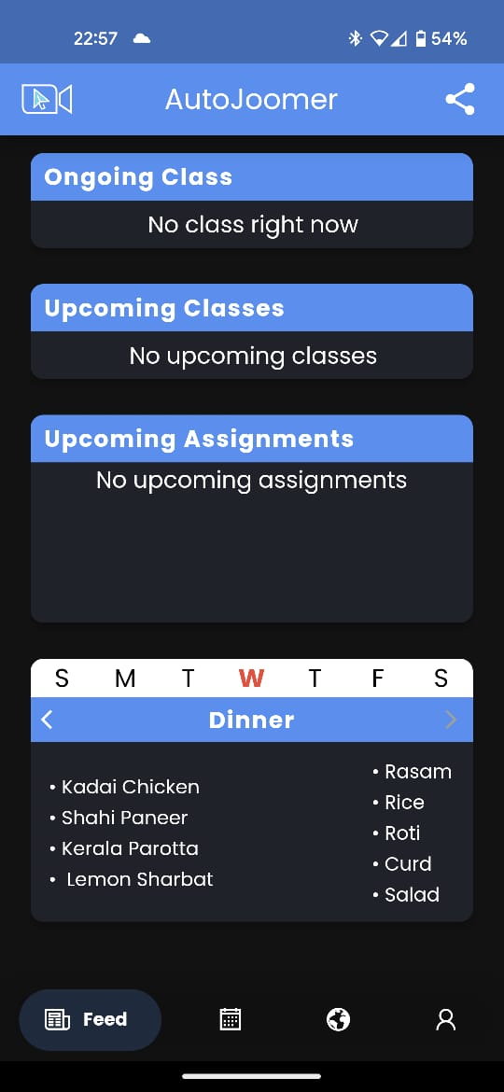
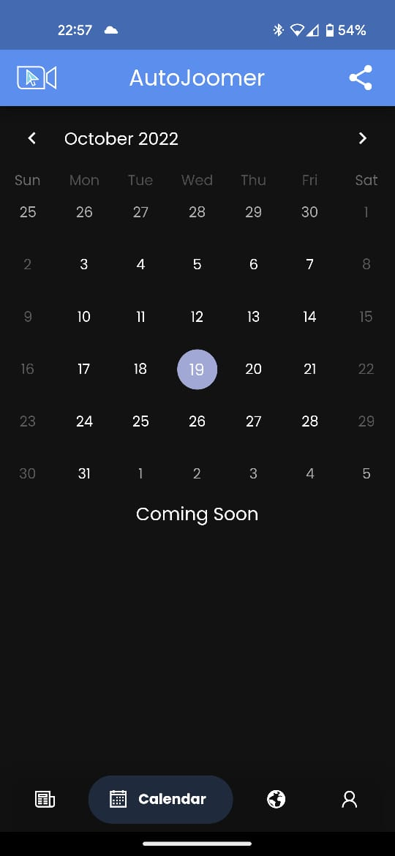
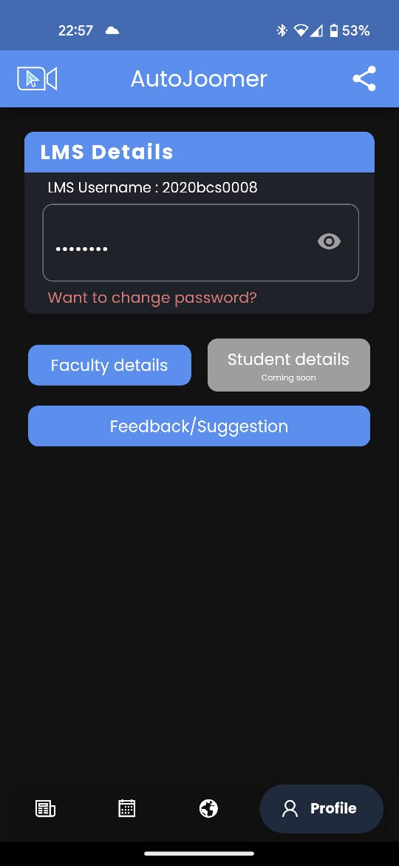

Slide 10
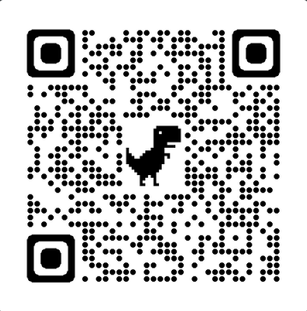
Thank you

